Slide 1
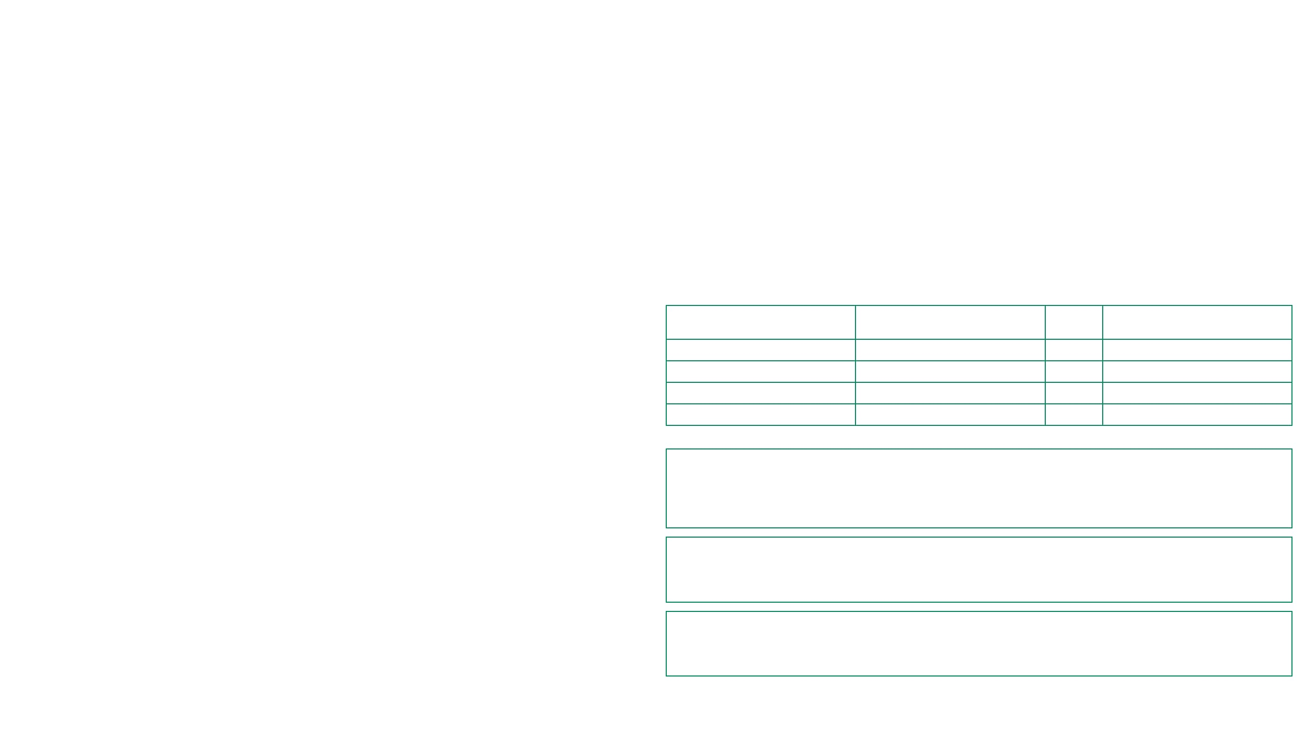
CLOUD THREAT INTELLIGENCE BRIEFING
Evidence indicates material exploitation of customer-managed network edges alongside a remediated shared-cloud isolation weakness. 2LoD prioritises external access, workload identities and supplier-managed control dependencies over unsubstantiated compromise claims.
Threat Landscape & Primary Incidents
Systemic Risk Impact & Recommendations
4+
12k
2LoD assessment: Compromise of an external access gateway or non-human identity can become enterprise-wide access to shared applications, data and network controls. Provider remediation reduces exposure only for named managed services, not connected customer-managed, legacy or supplier-operated estates. Cross-tenant residual-data exposure confirms shared-infrastructure assurance remains a dependency risk even absent reported malicious use. The EvilTokens token-theft campaign scale highlights systemic MFA bypass risk.
AFFECTED EDGE PLATFORMS
COMPROMISED ORG MAILBOXES
NetScaler ADC and Gateway Exploitation
CISA reported global active exploitation of two zero-day flaws. NetScaler states one permits unauthenticated command execution, while the second can cause code execution or denial of service when DTLS is enabled on VPN virtual servers.
Target CVE
Affected Software
CVSS
Primary Threat
CONTROL: Application-delivery and remote-access edge
CVE-2026-88771
NetScaler ADC / Gateway
9.5
Unauthenticated command execution
Compromised Azure Service Principals
CVE-2026-88772
NetScaler ADC / Gateway
9.5
Remote code execution (DTLS)
Microsoft observed a compromised tenant where service principals conducted extended discovery followed by destructive actions against storage and key-management resources. The initial compromise route remains undetermined; resource locks stopped some attempted deletions.
CVE-2026-76504
Cisco Catalyst SD-WAN
9.8
Administrator API bypass
CVE-2026-85102
Check Point VPN
9.8
Pre-authentication execution
CVE-2026-83548
SonicWall SMA 1000
10.0
Pre-authentication SSRF
CONTROL: Workload-identity privilege management
Cloudflare Containers Isolation Exposure
Remediate Exposed Access Gateways
Cloudflare disclosed that residual storage blocks in its Containers service could be read across tenants. The provider removed the unsafe setting and retired running disks, reporting no evidence of malicious use in reviewed telemetry.
Complete an independently evidenced inventory of exposed NetScaler, Check Point and SonicWall gateways; apply vendor fixes, disable unnecessary VPN services, and investigate indicators before business-as-usual closure.
CONTROL: Multi-tenant container-storage isolation
Constrain Workload Identities
Revalidate workload-identity ownership, secret rotation, privileged role scope and resource locks; require anomalous service-principal discovery and destructive-action alerts to reach central monitoring.
Assure Shared-Cloud Isolation
Obtain provider and key supplier assurance on tenant isolation, remediation scope and residual-data disposal; test contractual notification and evidence retention obligations across shared-cloud services.
Notes:
Internal evidence register - September 2026\n\nReporting Period: 1-30 September 2026\nEvidence Cut-off: 1 October 2026\n\n1. NetScaler ADC and Gateway Exploitation\n- Source: CISA Zero-day Alert (2026-09-28); NetScaler Security Bulletin (2026-09-30)\n- Claims: Global active exploitation of CVE-2026-88771 (unauthenticated command execution) and CVE-2026-88772 (RCE/DoS via DTLS).\n- 2LoD Assessment: Material threat to external application delivery and remote access edges. Managed cloud services are patched; customer-managed and legacy estates remain exposed until remediated.\n\n2. Compromised Azure Service Principals (Storm-3168)\n- Source: Microsoft Security Research (2026-09-25)\n- Claims: Active intrusions where service principals performed 300+ discovery operations followed by destructive deletion attempts against storage, key vaults, and app services.\n- 2LoD Assessment: Demonstrates risk of broadly privileged non-human identities. Resource locks and deletion protection are critical resilience controls.\n\n3. Cloudflare Containers Isolation Exposure\n- Source: Cloudflare Blog (2026-09-24)\n- Claims: Residual storage block reading across tenants due to unsafe dm-thin allocation setting. Provider-side remediation completed; no evidence of malicious exploitation found in provider telemetry.\n- 2LoD Assessment: Systemic dependency risk. Highlights importance of provider-side isolation assurance and residual data disposal controls.\n\n4. Critical Vulnerability Tracking\n- CVE-2026-88771: NetScaler ADC/Gateway, CVSS 9.5. Primary threat: Unauthenticated command execution.\n- CVE-2026-88772: NetScaler ADC/Gateway, CVSS 9.5. Primary threat: Remote code execution (DTLS).\n- CVE-2026-76504: Cisco Catalyst SD-WAN Manager, CVSS 9.8. Primary threat: Administrator API authentication bypass.\n\nPrior-period correction: None.

